Slide 1
MBC Partner Agencies: Working Together for Better Outcomes
Kate Jeffries, AnglicareWA

Slide 2
Acknowledgement
Ngaala kaaditj Noongar moort keyen kaadak nidja boodja
‘We acknowledge Noongar people as the original custodians of this land.’

Slide 3
Intersections & Intersectionality
Intersections
Homelessness
AOD
Intersectionality
Culture
Mental Health
Sexual Identity
Clients with concurrent issues where FDV may be a primarily factor
Factors already oppressing clients in their everyday lives which FDV provides further oppression for these minority groups.

Slide 4
Intersections
Lets look at the multiple pathways for opportunities to increase safety for women, children and families.

Slide 5
Housing Priority Lists
Housing Policy
NAHA/NAPA
Residential Tenancy Act
Victim Support /Family Violence Services
Counselling
Advocacy and Support Services
Safe at Home/
Outreach Services
Emergency Accommoda-tion
Entry Point
Crisis Accommodation
Services
FDV
Victim Engage-
ment
Mental Health
Justice Systems
Alcohol and Other Drugs
Child
Protect-
ion
Housing & Homelessness
Health
Housing Authority
24hr Services
Helplines
Crisis Care
Other Health Professionals
Family Support
Crisis and Emergency
GP’s
Child & Wellbeing Assess-
ments
Magistrates Court
Allied Health
FDVRT
Hospital
WAPOL
Helplines & Counsell-ing Services
Law & Legislation
Family Court
MH
Residential Services
AOD Residential Rehabilita-tion
Public Mental Health Services
MH Community Services
Comm-unity AOD Services
AOD Counsell-ing
Sobering up and Withdrawal
Notes:
Examples of intersections
Formal partnerships between peak bodies and government i.e. WCDFV(WA); WAFLPN; DCD (CP, Housing), Justice, participation on Women Refuge boards
Training across intersections – AOD services, case planning collaborations, FDV training in undergraduate and post graduate courses, School group work, Women’s services
Conferences and Forums – NADA, Mental Health Forums
Research: Curtin University, Our Watch, ANROWS, White Ribbon

Slide 6
Intersections and Partnerships
Policy
&
Research
WA Strategic Prevention Plan
FDV Leave
WA Residential Tenancy Act
ANROWS
Our Watch
White Ribbon
What is missing from landscape?
Department of Education
Community Awareness
Education
Prevention & Early Intervention
Community Health/ Nurse
Public Awareness Campaigns
University
&
Tafe
Primary Schools
High Schools
FDV Early Screening
Hey Mate
No More
Freedom
from Fear

Slide 7
Intersectionality
Culture
How are you providing Culturally Safe services?
Sexual Identity
How are you providing Safe Gender Diverse Services.
Who can you link in with to build this knowledge in these areas and share your FDV knowledge?
Notes:
Give time for participants to feedback? 5 mins

Slide 8
MBC Collaborations
for Partnerships and Collaboratively raising awareness across the intersections!

Slide 9
Building Relationships
Relationship Building = Trust
Notes:
Relationship building = Trust.
We create safety through relationships.
Who can you call in critical moments of safety and they know if you have called they will try there best to help?
Who can you call for case planning?
Who can you call to flag concerns?
Is makes a difference example of court client.
What about making opportunities come alive? How can we get better and delivering services – Supporting men to various programs through transportation, breaking down the barriers. In case planning we are looking at breaking down barriers i.e AOD client transported to programs however this doesn’t happen for MBC participants – we want them accountable.
What do we want more? accountability or safety. Could transporting men to programs help increase safety by breaking down barriers for engagement.

Slide 10
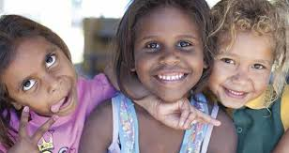
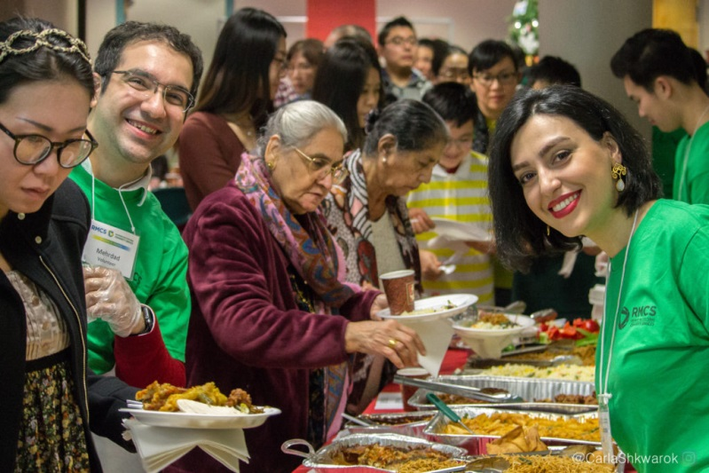
Collectively We Want:

